Slide 1
Factor Graph
Akif Adas
Date: 10.07.2025

Slide 2
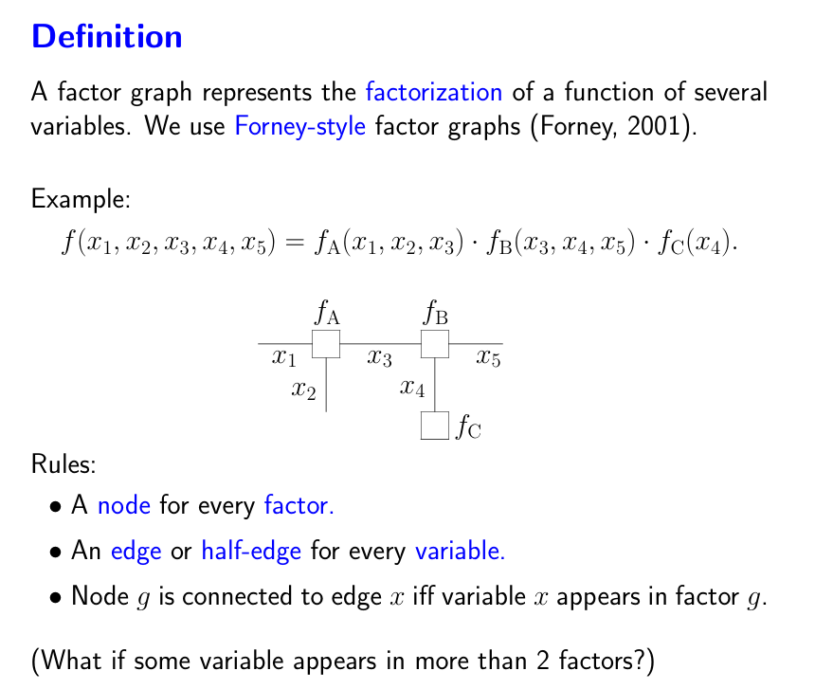
Idea

Slide 3
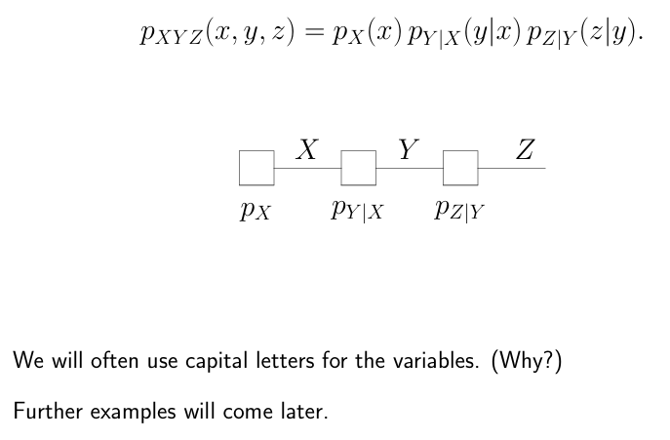
Markov Chain

Slide 4
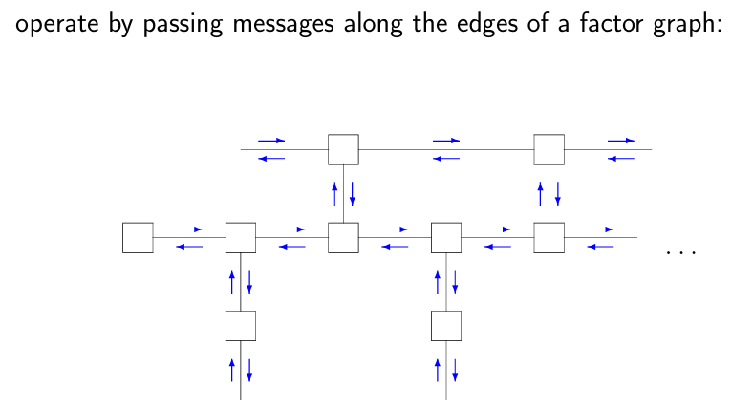
Message Passing

Slide 5
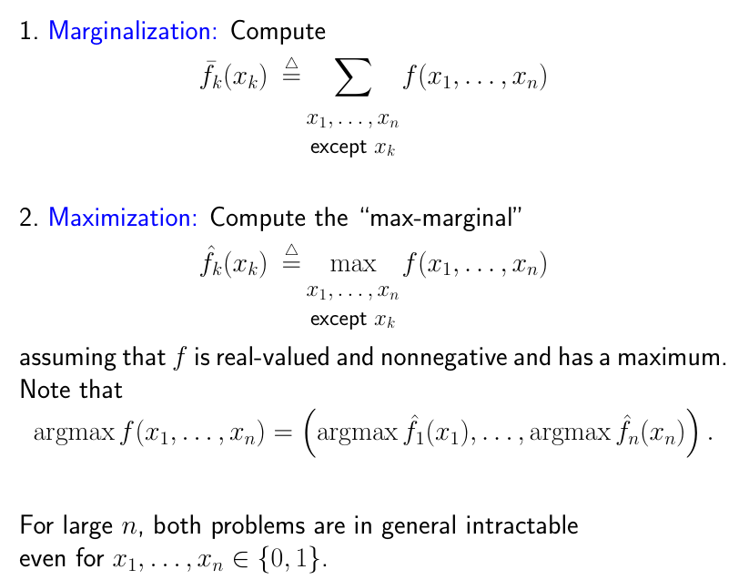
Basic Problem

Slide 6
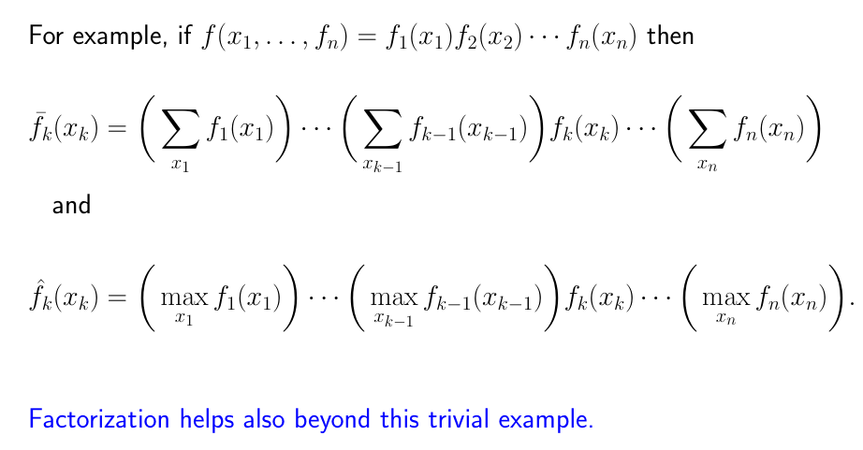
Factorize

Slide 7
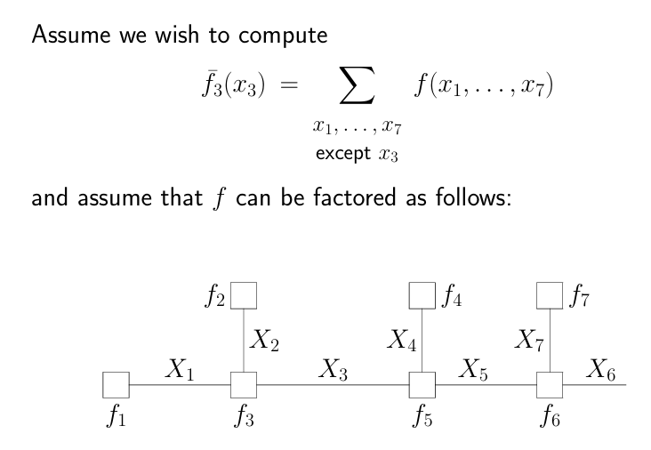
Example – Towards Sum-Product Algorithm

Slide 8
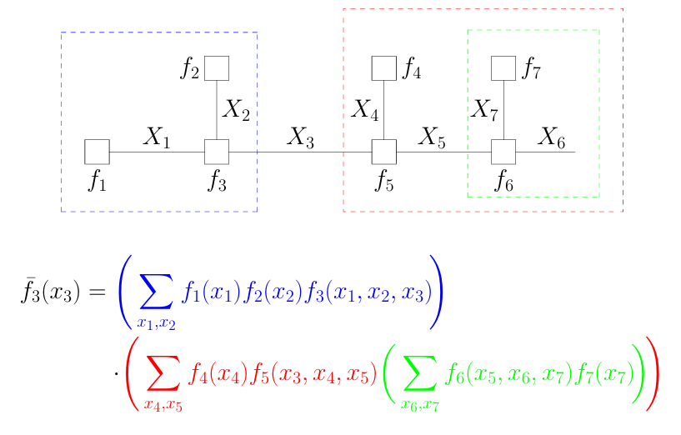
Example Continue

Slide 9
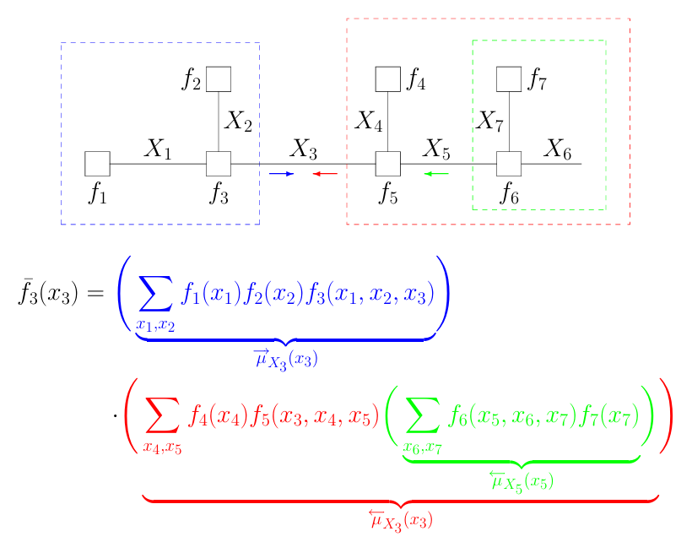
From MP view

Slide 10
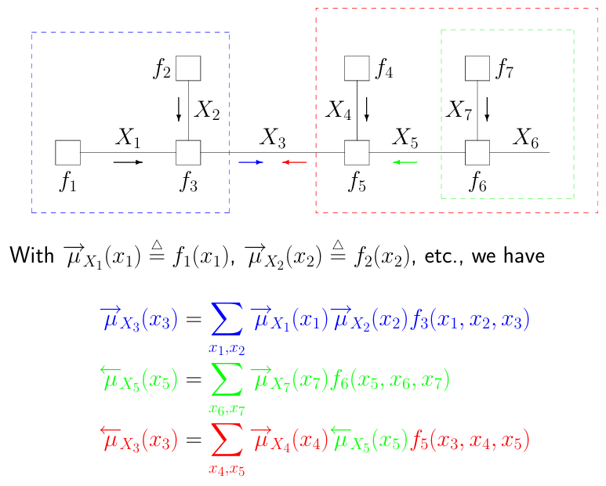
From MP view continue

Slide 11
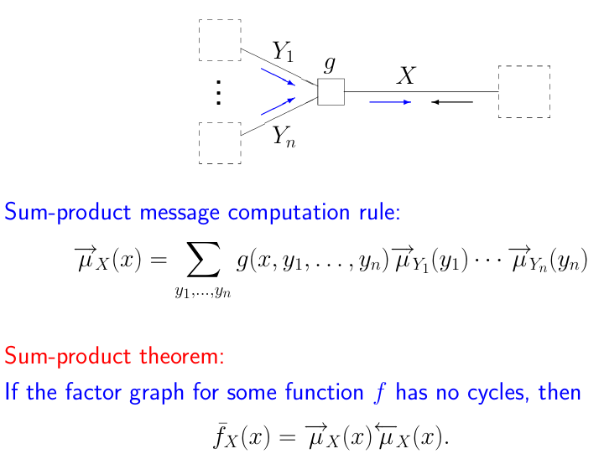
Sum-Product Algorithm

Slide 12
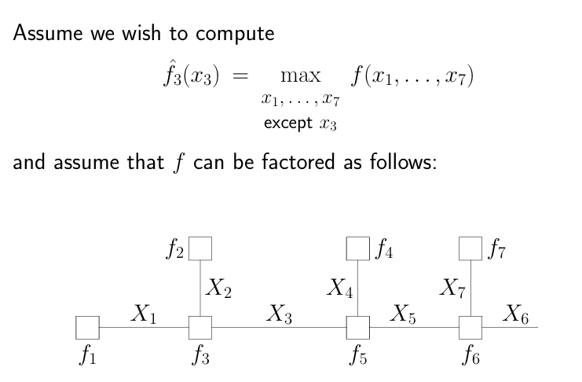
Example – Max-Product Algorithm

Slide 13
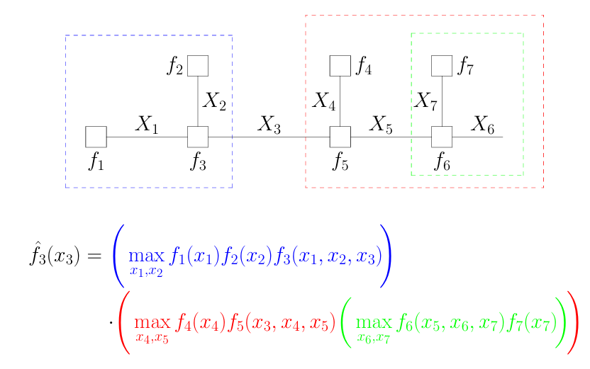
Example - Continue

Slide 14
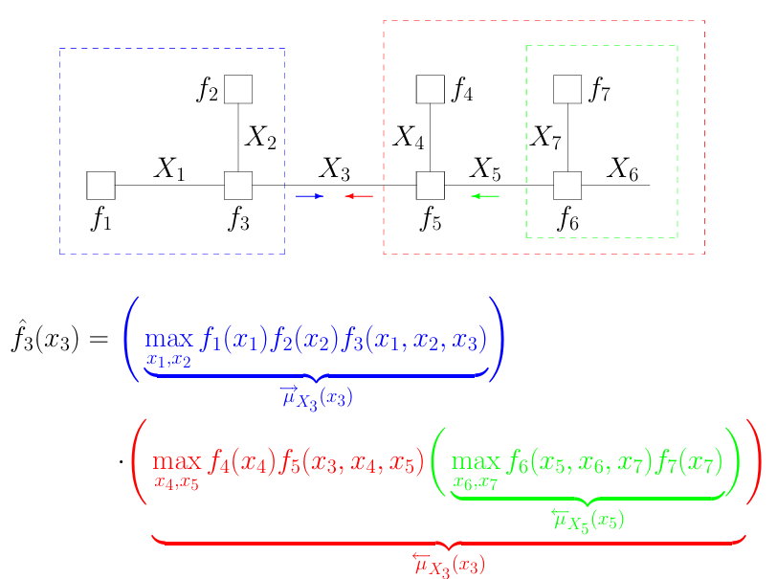
Example MP view

Slide 15
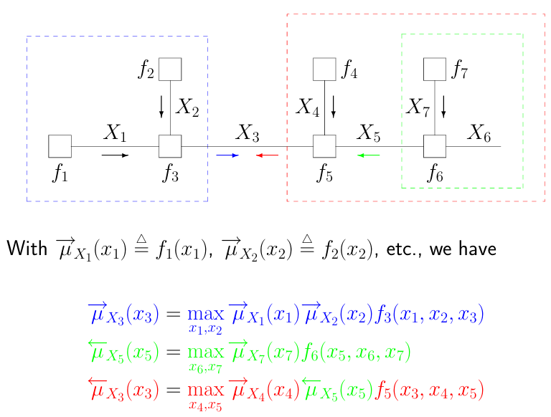
Example MP view continue

Slide 16
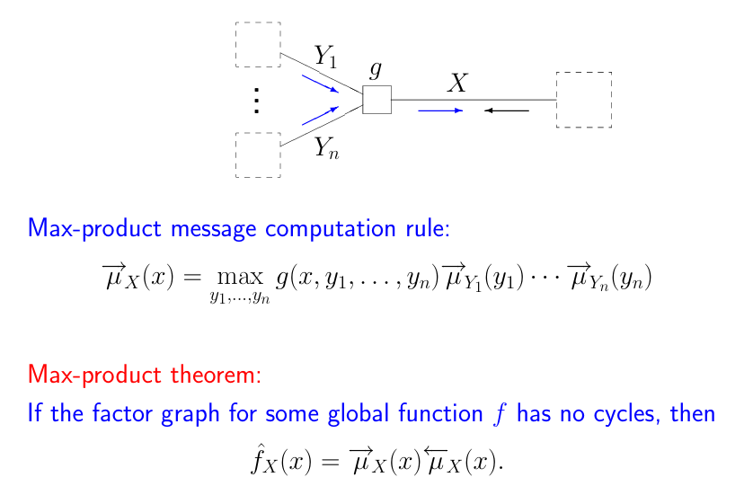
Max-Product Algorithm

Slide 17
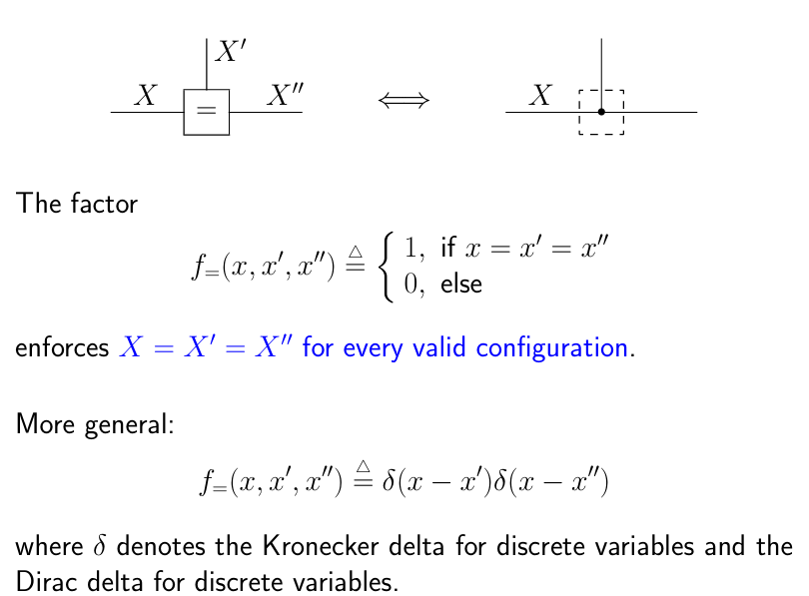
Branching Point

Slide 18
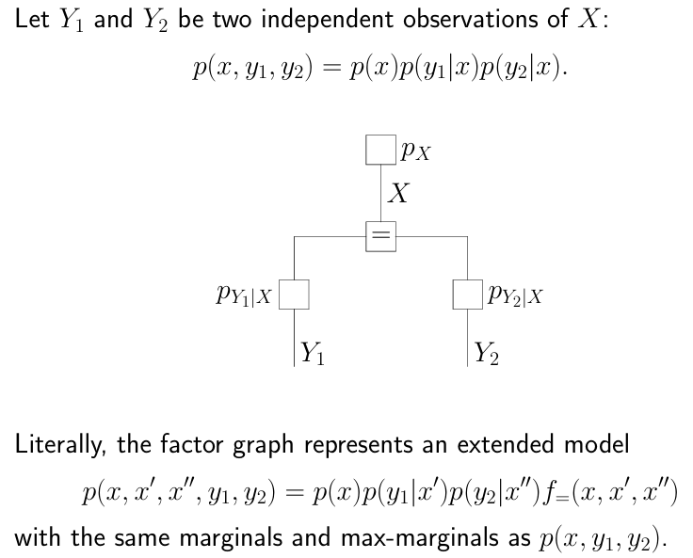
Example

Slide 19
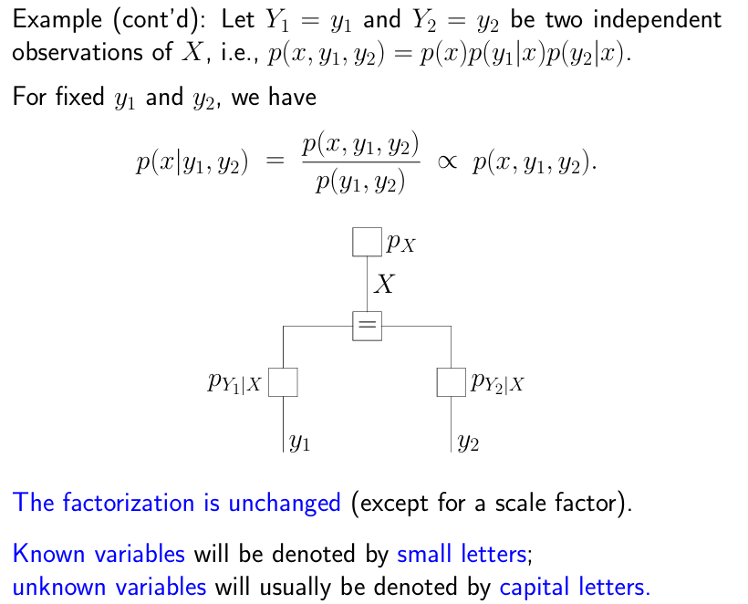
Example Continue

Slide 20
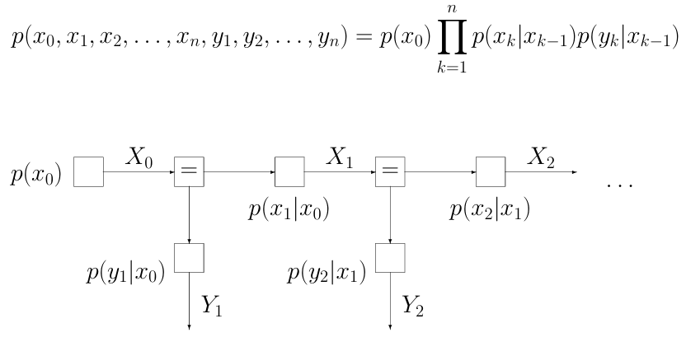
Hidden Markov Model (HMM)

Slide 21
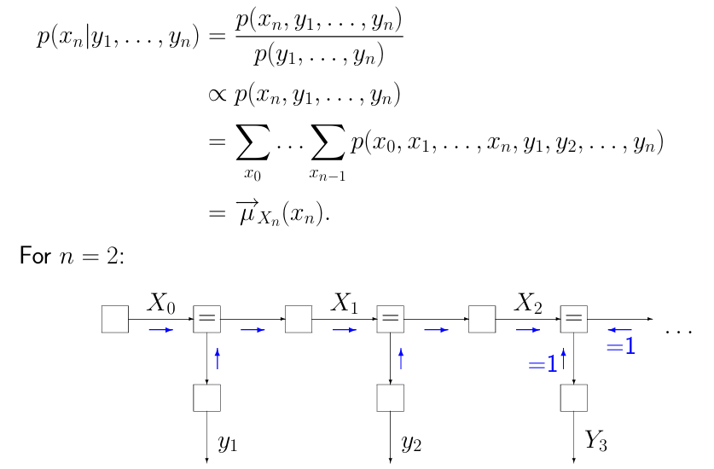
Sum-Product HMM

Slide 22
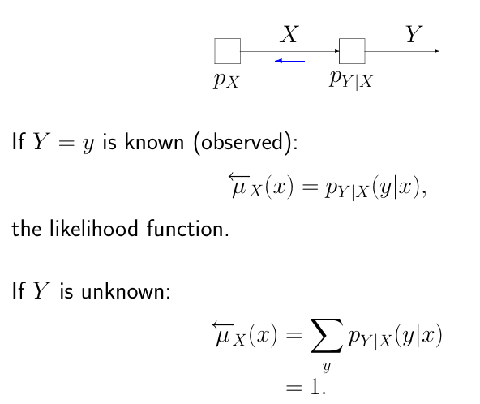
Backward Message Chain Rule
No information

Slide 23
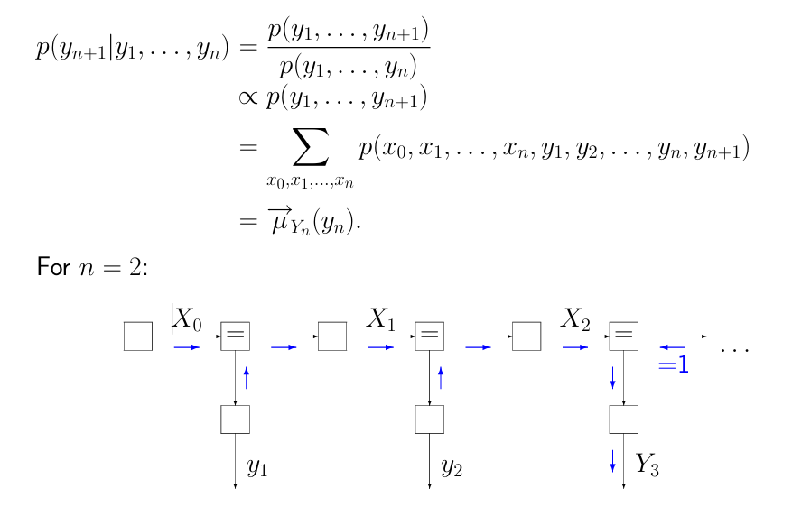
Probability of Next Observation

Slide 24
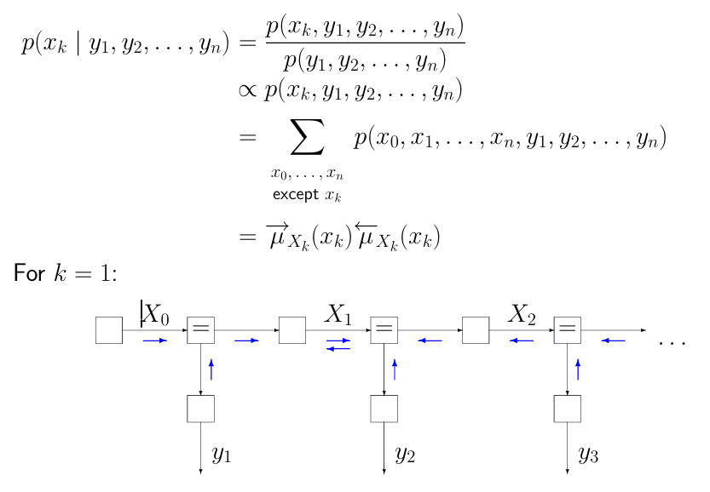
Estimation of State at time = k

Slide 25
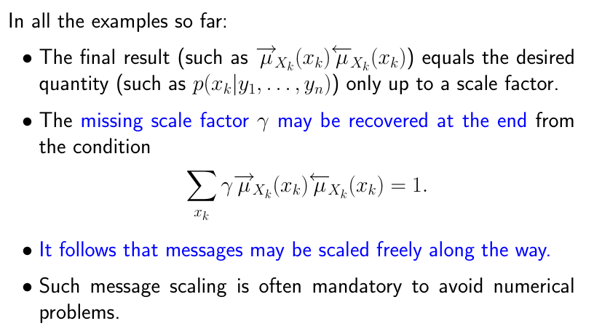
Scaling of Messages

Slide 26
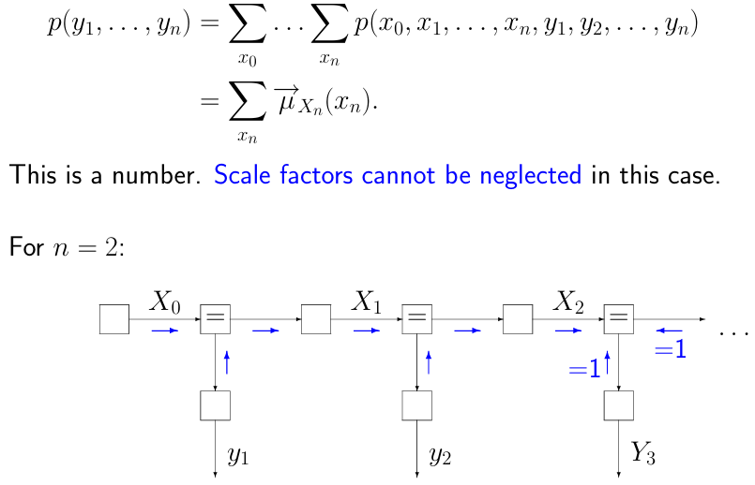
Probability of the Observation

Slide 27
Summary
Many algorithms can be realized with Factor Graphs:
  Belief Propagation, Viterbi, Kalman Filter, Turbo Codes, Fast Fourier Transform.

Slide 29
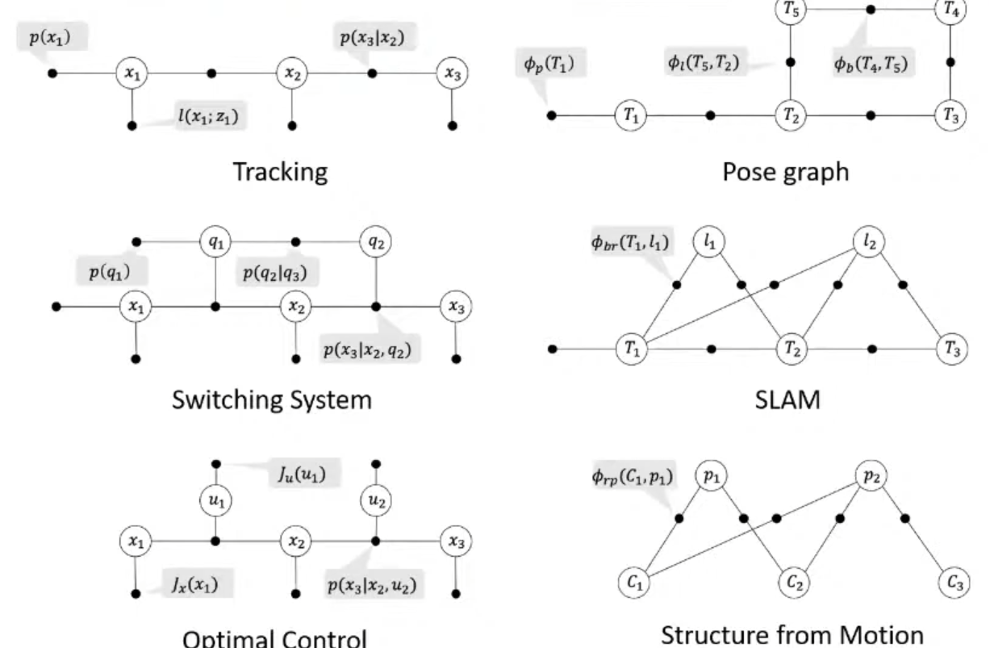
Other Factor Graphs in Implementation
Offline
So all the data is there
Notes:
https://www.youtube.com/watch?v=JmR2YpkLNt0&list=PLk8QvwfyO2Nu52g18PrdrMPf57bgmL3HE&index=9

Slide 30
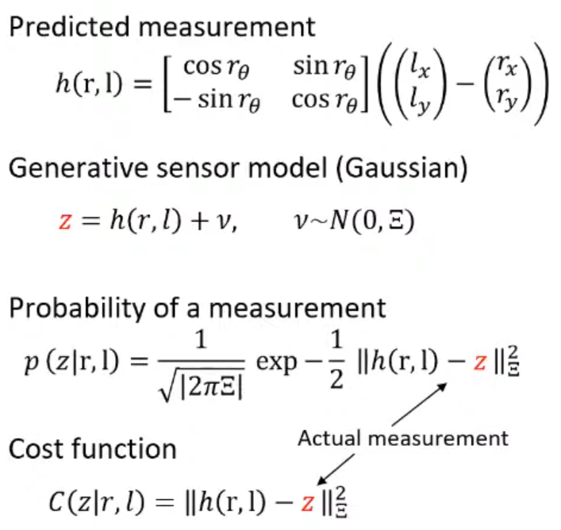
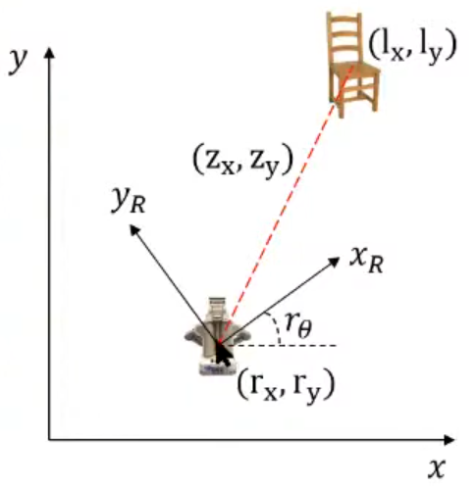
Example - SLAM
A robot observing a landmark in 2D

Slide 31
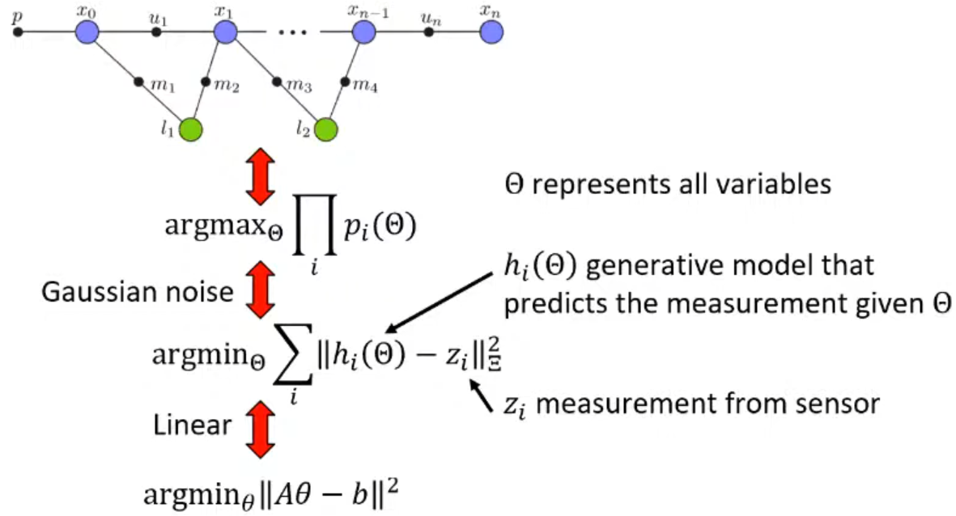
Example – SLAM (2)
We are looking for the state estimate
that maximizes probability that best explains
the measurements we got

Slide 32
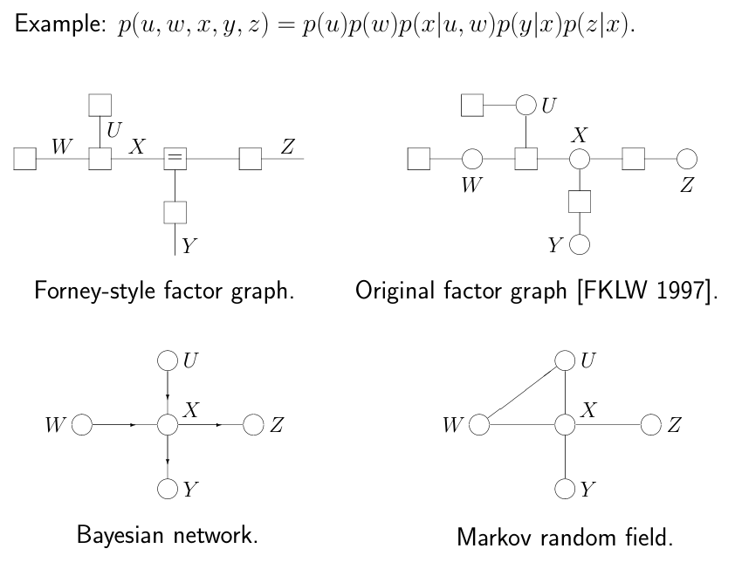
Other Notation Systems

